Slide 1
Managing Human Resources

Slide 2
Human resources (HR)
Larger businesses usually have whole departments dedicated to managing HR (e.g Asos, Apple, BT)
Some businesses, usually small businesses, choose to outsource the
management of their HR either:
Entirely
just for specific functions, such as payroll (e.g payroll, recruitment)
They may do this to save money or to draw on specialist expertise which they do not have within their business.

Slide 3
HR functions are needed for:
Appraisals
Promotions
Holidays, sick leave
Reward, pay, pensions etc
Employee relations
Recruitment and selection
Organisation structure
Compliance with legislation
Budgets
Professional development

Slide 4
Human resources as a factor of production
Resource is a term used in economics, and human resources as a factor of production
Relates to the resources required to produce goods or deliver services.
Resources can be both human and physical and include equipment, technology etc.
The HR department is involved in managing physical resources by monitoring the effectiveness of teams and individuals, involving human managers primarily.
E.G managers are directly responsible for their teams and therefore any requests for increased resources usually require approval from HR. HR will either have a budget for resources or monitor managers’ spending against the budget for resourcing.

Slide 5
Labour market analyses
HR departments rely on analyses of labour market information to evaluate the supply and demand for skills and the effect of regulatory changes on businesses.
Gathering and analysing this type of data is not solely the responsibility of HR departments as it is required for all departments and especially managers, to plan for sustainability.
The gathering of this information is often referred to as market intelligence.

Slide 6
HR departments use data analyses to evaluate and plan strategically for:
▸Workforce requirements
▸Policy changes in light of government legislation
▸Anticipating contingencies for future government intentions, such as elections and party mandates
▸Measuring the availability of skills in the global market and possible impact on the organisation (for example the gaps in literacy and numeracy skills in the UK)
▸Forecasting skills which will be needed in the future (such as international trade and export and areas that have skills gaps)
▸Education and training impact for future employees (for example, the shortage of skilled employees since the early 2000s due to limited opportunities for developing new engineers; future shortages in computing and manufacturing).

Slide 7
As well gathering external data, HR departments will compare it with internal data, often produced by departmental managers such as:
▸Performance against targets
▸Budgets
▸Health and safety reports
▸Customer and employee feedback
▸Employee movements, such as holidays, sick or maternity leave, punctuality,
performance, resignations etc.

Slide 8
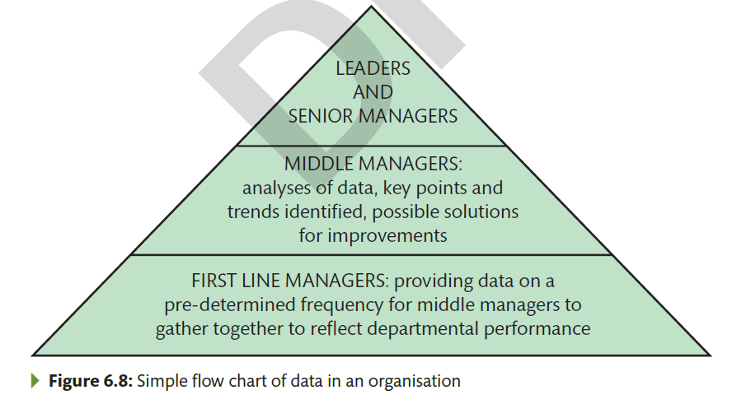

Slide 9
HUMAN RESOURCE PLANNING
The process of HRP may be outlined as follows :
Forecast demand for each grade and/ or skill of employee
Forecast supply of each grade and/ or skill of employee, both within and outside the organisation
Plan to remove any discrepancy between demand and supply. If there is a shortage of labour, the need to reduce demand (say through improved productivity), or improve supply (through training of staff or recruitment)

Slide 10
HUMAN RESOURCE PLANNING
Human Resource Planning involves the following:
Recruiting the required number and quality of staff
Retaining the required number and type/ quality of staff
Utilising staff in the most efficient and effective manner: increasing productivity, introducing multi-skilling
Improving the skills, capabilities and motivation of staff so that they increase their skills and are capable of filling higher level vacancies

Slide 11
HUMAN RESOURCE PLANNING
The key to successful HRP is getting the RIGHT PEOPLE into the RIGHT JOBS at the RIGHT TIME
Group Activity
In groups suggest three possible reasons why a business might find itself experiencing a shortage of a particular skill/type of employee ANSWER

Slide 12

HUMAN RESOURCE PLANNING
WHY IS HRP NECESSARY?
To plan for training of staff who’s skills are in short supply – training must be planned & delivered in advance and this must be ongoing to ensure there will be an adequately skilled workforce for the business
Employment protection legislation – It takes time to shed employees which can give businesses a bad reputation. Therefore when recruitment is required it may make it more difficult and may even alienate customers and potential customers

Slide 13
HUMAN RESOURCE PLANNING
Rapid technological change – As this increases the need for retraining of staff to be able to use new technology (e.g. computers). Also staff must be assessed for their retraining potential and Labour Flexibility
Specific skills shortages – As there are specific skills shortages in some industries (e.g. education) careful planning will be required

Slide 14
HUMAN RESOURCE PLANNING
LABOUR MARKET INFORMATION
Businesses need to look at the following types of external labour market information
Local employment trends – These are the employment figures for an area like Bradford. Firms need to monitor these so that they can assess whether there will be adequate employees available for them when needed.(particularly new companies)
Local skills shortages – These give details of the type of anticipated skills shortages that businesses may have in a particular area. Businesses will have to look at the figures to plan future training programmes

Slide 15

HUMAN RESOURCE PLANNING
Competition for employees – In certain areas of the UK (e.g.London) there will be greater competition for employees. Therefore businesses will have to look at the location of their businesses and think about possibly offering better remuneration packages to its employees to retain staff
Availability of labour – These are the unemployment figures in a given area. Where unemployment is high, it will be easier to find employees, however this will depend on the type of skills that they are looking for

Slide 16

HUMAN RESOURCE PLANNING
THERE ARE INTERNAL FACTORS FOR BUSINESSES TO CONSIDER:
Labour turnover – This is the number of employees leaving an organisation and being replaced.
Sickness – Obviously employees will be sick and organisations will have to have contingency plans in place like temporary staff and promote multiskilling within the business to cover absence.

Slide 17
HUMAN RESOURCE PLANNING
Age, skills and training – Businesses will have to look at the age structure of their workforce and know when exactly employees will be retiring in order that they can adequately train replacement staff
Succession – This is the process by which one person ‘succeeds to’ or takes over the office or post of another person. This planned process is essential to ensure the continuity of performance in the organisation (particularly the management planning as if there is no ‘groomed’ successor it would leave a gap in the organisation structure

Slide 18
HUMAN RESOURCE PLANNING
Task
What do you think are the main reasons for high labour turnover in schools and supermarkets? Create a table giving reasons for both.
Also the economic climate and the state of the jobs market will affect labour turnover as where unemployment is high, labour turnover will be lower.
Age and length of service of employees as it has been found that labour turnover is highest among young people, especially unmarried and no family and people who have only been in employment for a short time

Slide 19
REASONS FOR HIGH LABOUR TURNOVER IN SCHOOLS | REASONS FOR HIGH LABOUR TURNOVER IN SUPERMARKETS

Slide 20
Need for flexibility in the workforce
HR planning involves structuring a workforce who can be flexible, as no individual works in isolation of others and is always part of a larger team when you consider both internal and external customers. A sole trader is still part of a team otherwise they wouldn’t have a business.

Slide 21
Types of workers
Core versus peripheral workers
Full-time versus part-time workers
Sub-contracting
Zero hours contracts
Temporary staff
Agency staff

Slide 22
Management actions to address human resource issues at an operational level:
Managers are responsible for the smooth operation of their department which includes all its resources.
Example:
A member of staff has complained about unfair treatment by another individual. While the matter might have come to the attention of the HR department as a formal complaint and therefore been passed back to the manager to resolve, it may also have been reported directly to the manager informally. Either way the manager is required to sort out the issue to the satisfaction of all parties.

Slide 23
Motivation
HR planning involves development and training of the workforce. Businesses
where employees receive little or no personal development, or where there are
few opportunities to progress within the organisation, will lack a motivated and
stimulated workforce, and these employees are also less likely to be retained. Although
it may be assumed that many small businesses or sole traders may lack capacity to
train their employees, the government highlighted that two-fifths of UK businesses
do not train their staff, including more than half those at managerial level and even in
the public sector staff can be missing out on continuing professional development
(CPD).

Slide 24
Engagement with business culture
HR play a major role in the business culture through successful planning and ensuring employees are maximising opportunities for job satisfaction and striving for continuous improvement.
It is not an HR function to engage with business culture but rather to generate an ethos which employees recognise and portray. Reflecting on the characteristics explored throughout this unit, you might consider HR to be the hub of a business.

Slide 25
Employee satisfaction
HR also have some responsibility for ensuring that the best potential applicants apply in the first instance by giving the best impression of the business as a place to work; for example, attracting graduates or learners considering their options for management training programmes before they leave university, school or college. Examples of businesses that demonstrate consistently high levels of employee satisfaction include Google and John Lewis Partnership (JLP).

Slide 26
Making its Mark
Read through case study and answer questions on page 97

Slide 27
